Slide 1

AIKTC – Anjuman-I-Islam’s Kalsekar Technical Campus. Department of Computer Engineering
SE Mini Project-1A
Presentation 1
On
ADVENTURE BALL GAME
By
Roll No. Name of Students
23DS30 DULDULE USAID SAAD
23DS41 KOHARI AAKIF ASIF
23DS23 ANSARI TABEER ASAD TANVEER
23DS49 RAIS MOHD NOOH MUJEEB
Guided by
PROF SAFIA SADRUDDIN

Slide 2
OUTLINE
Introduction
Problem statement
System Design and Architecture
Implementation Details
Proposed Methodology / Techniques
Demonstration
Next On Our Agenda
Conclusion
References
A.I. Kalsekar Technical Campus, New Panvel.

Slide 3
INTRODUCTION
Welcome to Adventure Ball, a fun 2D platformer game where you control a lively tennis ball. Developed in Java, this game delivers non-stop entertainment and excitement.
Explore complex levels and obstacles
Improve your hand-eye coordination and problem-solving skills
Enjoy a healthy dose of competition and entertainment for all ages
Experience colorful graphics and engaging sound effects
Get ready to bounce, jump, and roll your way to victory!
Motivation: Classic platformers like Super Mario B., incorporating elements like challenging levels and rewarding gameplay.
Objectives: Our primary objective was to create a fun and engaging game that showcases our understanding of game development principles and utilizes advanced programming techniques.
A.I. Kalsekar Technical Campus, New Panvel.

Slide 4
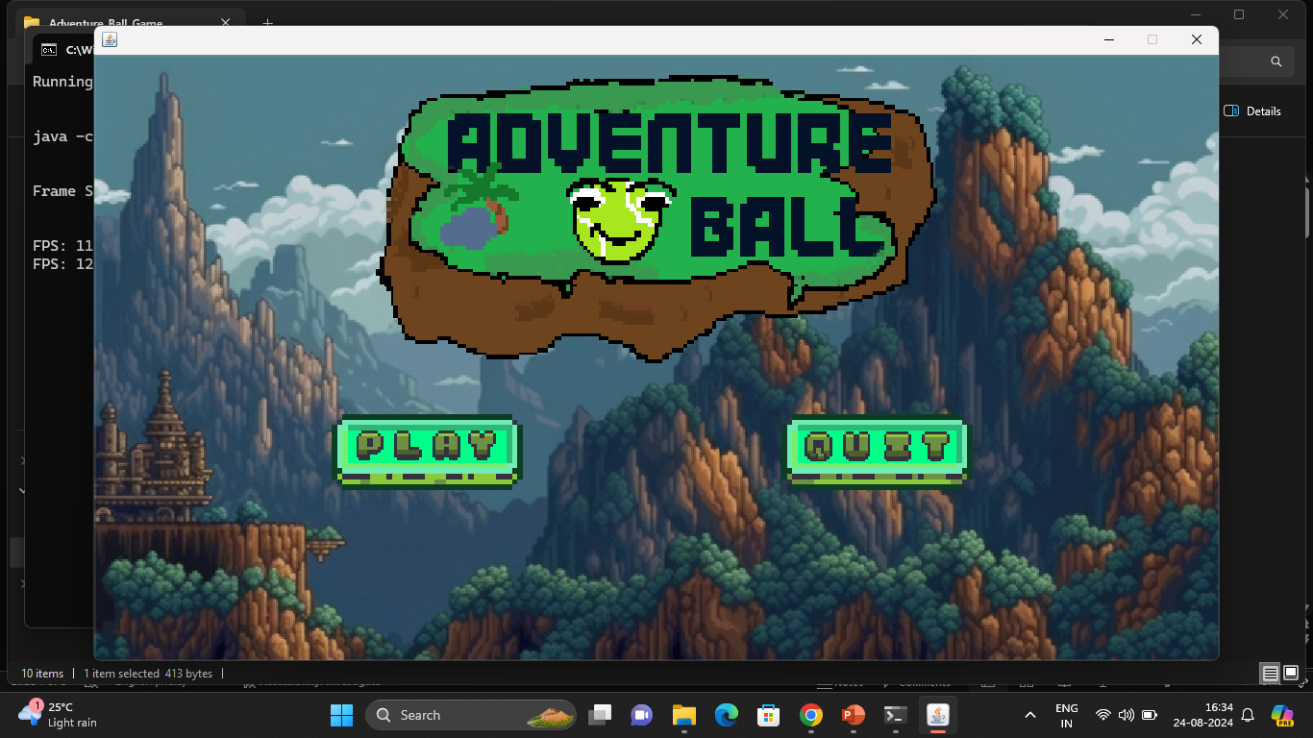
PROBLEM STATEMENT
Making of a 2D platformer game using java GUI framework for Entertainment Purpose. Perfect for Players of all ages looking for fun and challenging experience.
A.I. Kalsekar Technical Campus, New Panvel.

Slide 5
SYSTEM DESIGN AND ARCHITECTURE
Graphics of the game designed in pixelated style are made from:
https://www.pixilart.com/
Java Packages and classes are in the following structure:
main
gamestates
levels
inputs
KeyboardInputs
Game
GameState
Level
MouseInputs
GamePanel
Menu
LevelManager
GameWindow
Playing
utilities
MainClass
State
Constants
StateMethods
entities
HelpMethods
Entity
ui
LoadSave
Player
MenuButton
A.I. Kalsekar Technical Campus, New Panvel.

Slide 6
IMPLEMENTATION DETAIL
Controls:
‘a’ and ‘d’ keys are used to move left and right respectively.
Spacebar is used to jump.
Left Shift is used to dash.
Mouse Left Click is used to attack.
Software Tools:
Eclipse Integrated Development Environment (IDE).
Java programming language and its Libraries such as awt, swing, etc.
Java Classes Like KeyListener, JFrame, JPanel.
A.I. Kalsekar Technical Campus, New Panvel.

Slide 7


PROPOSED METHODOLOGY /TECHNIQUES
The game features a bouncy ball character navigating challenging levels filled with obstacles, enemies, and collectible items like “COINS”.
An array of Buffered Images are used to load the basic 7 tiles used to design our game. Then a data image where every pixel correspond to a certain RGB value is loaded. And according to this value level's tiles are drawn.
For animations according to the user inputs the ball's character iterates through an array of images giving the effect of an animation.
A.I. Kalsekar Technical Campus, New Panvel.

Slide 8
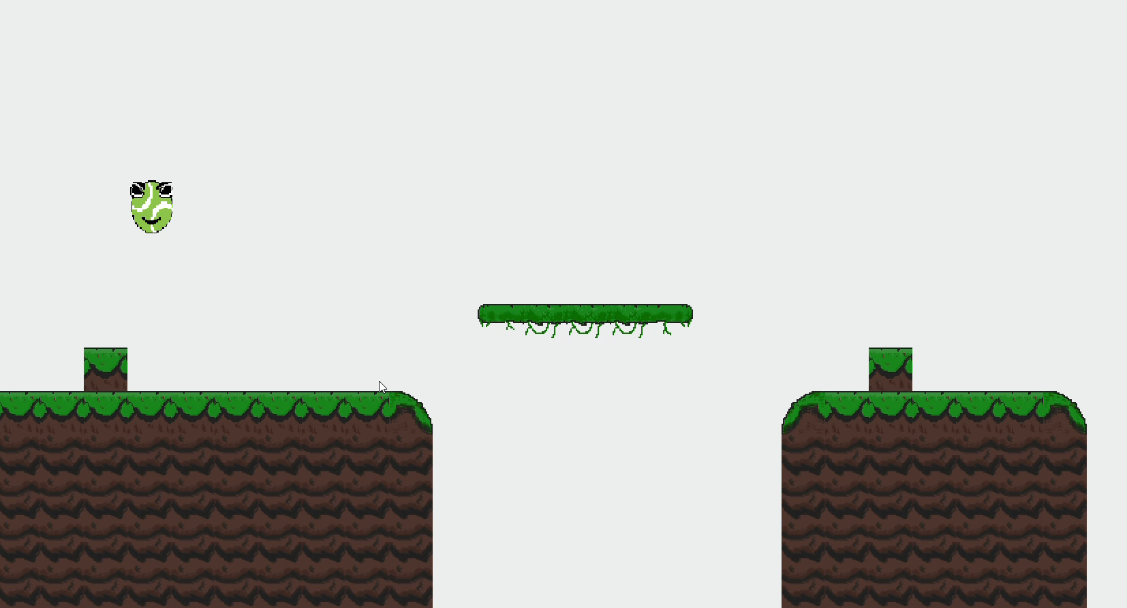
DEMONSTRATION
A.I. Kalsekar Technical Campus, New Panvel.

Slide 9
NEXT ON OUR AGENDA
Incorporating features such as:
Collectable Coins
Enemy Ball
Obstacles (such as spikes)
Timer
Scoreboard
Surrounding Background
Levels
A.I. Kalsekar Technical Campus, New Panvel.

Slide 10
CONCLUSION
The Adventure Ball Game developed using Java Language successfully demonstrates an engaging and enjoyable user experience. Key highlights include:
Engaging level design with varying coin placement and obstacles.
Visual feedback and animations enhancing the gaming experience.
Scoreboard and coin collection system encouraging competition.
This project showcases the effective application of Java Swing and Object Oriented Programming in game development, providing a solid foundation for future enhancements and expansions.
A.I. Kalsekar Technical Campus, New Panvel.

Slide 11
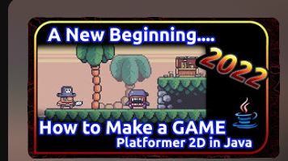
REFERENCES
https://www.youtube.com/playlist?list=PL4rzdwizLaxYmltJQRjq18a9gsSyEQQ-0
A.I. Kalsekar Technical Campus, New Panvel.

Slide 12
Thank You
A.I. Kalsekar Technical Campus, New Panvel.
Notes:
In Slide Show mode, select the arrows to visit links.

